Slide 1
An Individual Participant Data Meta-Analysis of the Machine Learning Models in Predicting Customer Churn
Khanh Tran
August 30, 2024

Slide 2

An Individual Participant Data Meta-Analysis of the Machine Learning Models in Predicting Customer Churn
Sciences Building | August 30, 2024

Slide 3
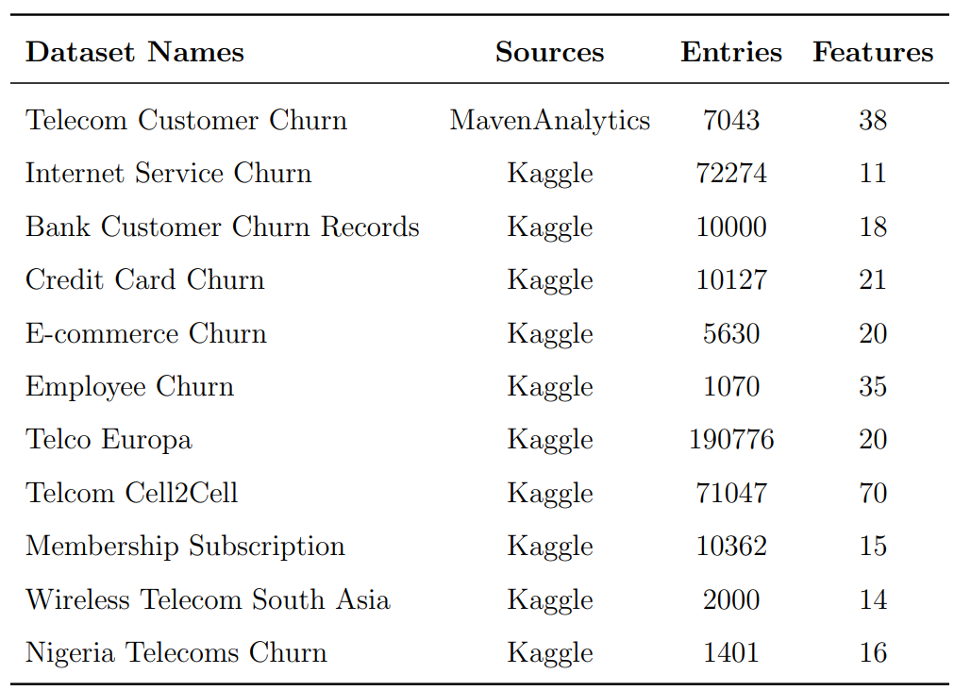
Dataset Summary

Slide 4
Methodology
Individual Dataset - EDA & Processing
Interpret the results
Individual Dataset - ML Models Evaluation
Residual Heterogeneity Estimates
Aggregated Metrics Mean & Standard Error by ML Models and by Datasets
Estimate Pooled and CI of Effect Size by Using Fixed & Random Effect Methods

Slide 5
Single column layout

Slide 6
Two-column layout
Quick Tips: Use this space to highlight key points on your topic. Try to keep the information concise.
Charts default to the first colours in the palette but you can change them to add a different highlight by clicking inside the graph.

Slide 7
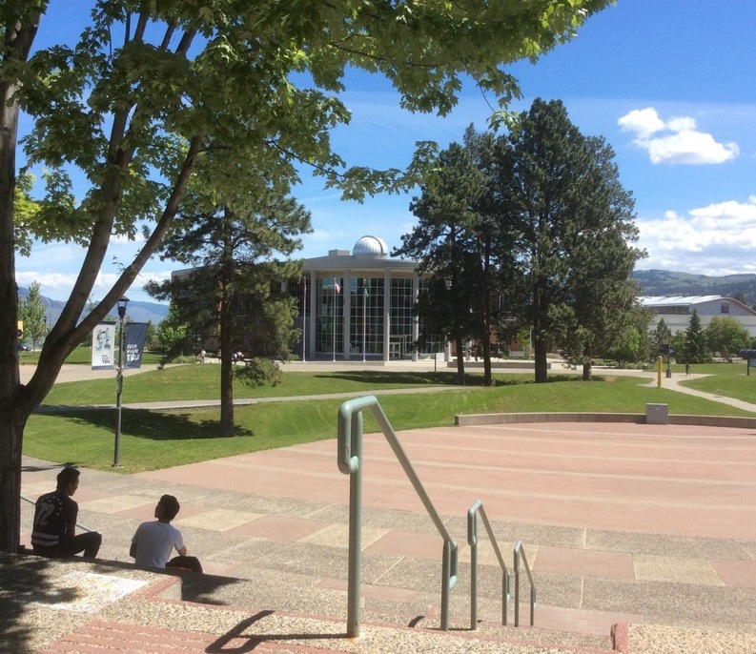
Two-column layout with image
If you type in this field titled you get Arial. This is used for lists and general body copy.
Hit return and tab and the text changes to Arial bold.
Hit return and tab again and it changes to a bulleted list
A fourth tab sequence is an italic serif
A fifth is a regular style serif

Slide 8
Section Heading
Or a transition slide

Slide 9
Right two-thirds column layout
Chart, tables or other information
This section could be used to highlight specific information on a chart or table.

Slide 10
Left two-thirds column layout
Use this space for a call-out. Any text that you want to amplify as important could go in a colored text block like this one.
If you want to create a block similar to this one see slide XX for alternate colour options.

Slide 11
“
Quotation here…..
”

Slide 12
Three-column layout with subhead
This slide is best used for key points or comparisons

Slide 13
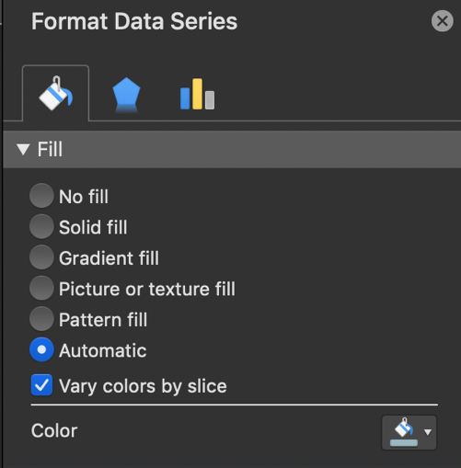
Three-column layout
This slide is best used for key points or comparisons. You can use charts, images or copy. If you want to change the style of chart (right click > change series chart type) or change highlight colours by clicking a section and choosing a new fill.
Fill colour

Slide 14
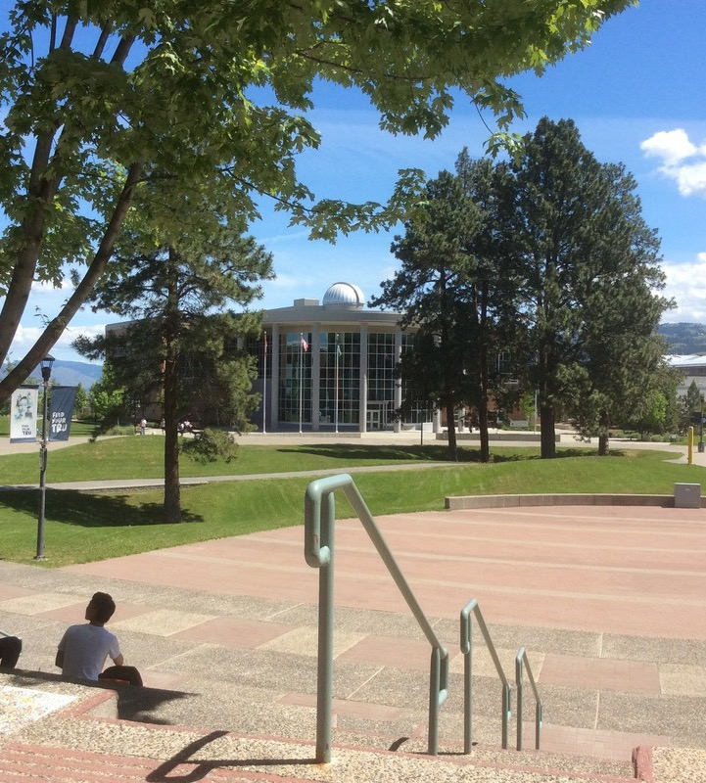
Half and half layout

Slide 15
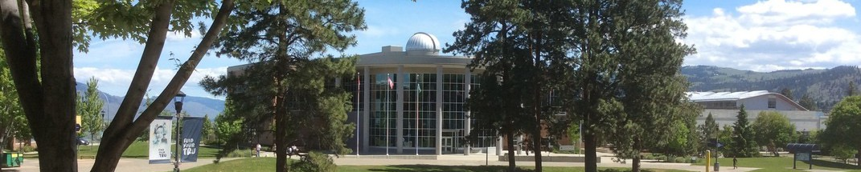
Banner image with single column

Slide 16
Call Out Box Options
Gradient 1
Gradient 2
Gradient 3
Solid Fill with Shadow
Solid Fill with Shadow
Solid Fill with Shadow

